Slide 1
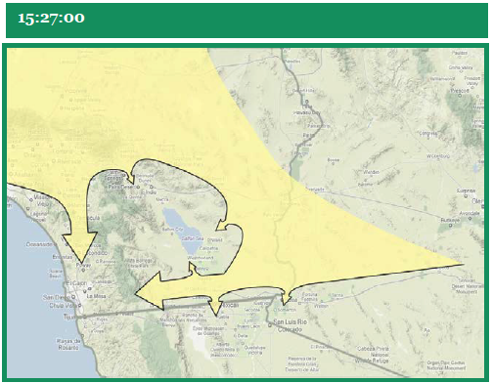
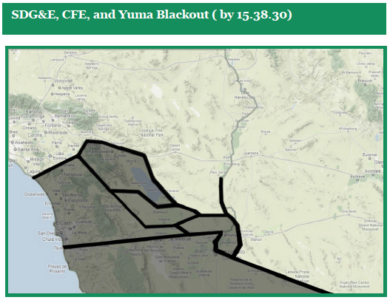
Patrick Soltis
Mitigation of malicious attacks on Californian power transmission network

Slide 2
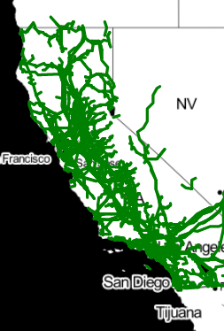
The data
High-quality shapefiles
Detailed characteristics
Spent 3/5 of time adapting and filtering
https://hifld-geoplatform.opendata.arcgis.com/

Slide 3
Malicious Attacks
Until s(q) < 0.1:
Calculate highest degree
Remove node with highest degree
Reasoning: Targeted attacks go for known vulnerabilities
$$s\left(q\right)= \frac{N in largest connected component}{N in full network}$$
Reasoning: Operators stabilize connected areas
s(q)
1
3/5
1/5

Slide 4
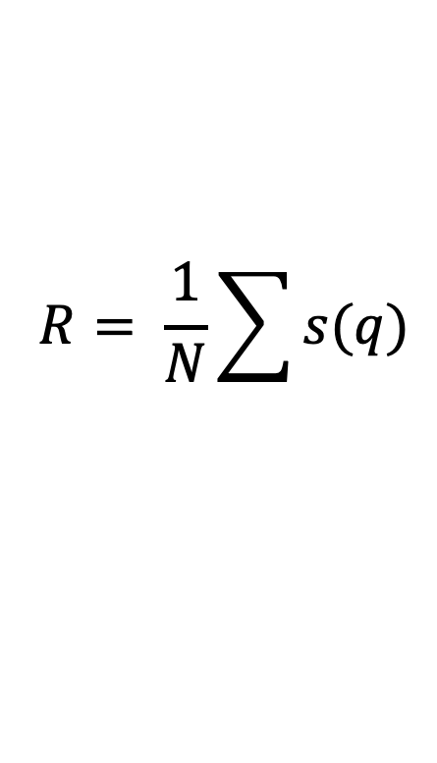
Measuring Robustness
$$R= \frac{1}{N}\sum{s(q)}$$
All s(q) until s(q) < 0.1
Larger when largest connected component is larger
Larger when connected components last longer

Slide 5
Improving network
Lines adjusted if:
New combined length < Old combined length (cost)
Voltage rating the same (capacity)
Adjustments retained when:
R increases
Process stops when:
R does not increase after 20 attempts

Slide 6
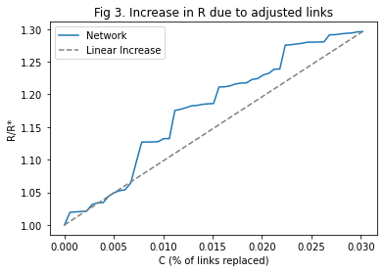
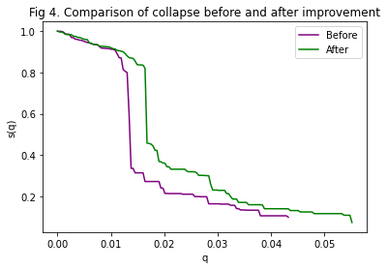
Conclusions
3% adjustment (108 lines)
0.3% improvement (+10 substations)
Not as well as for EU, but many caveats
Further Study
Is it worth the cost?
Look at adjusted lines
Analysis for full US
Integrate data for real-time operating state

Slide 7
Sources
Motivation: https://www.ferc.gov/sites/default/files/2020-07/Arizona-SouthernCaliforniaOutagesonSeptember8-2011.pdf
Data: https://hifld-geoplatform.opendata.arcgis.com/
Key paper: https://www.pnas.org/content/108/10/3838
Questions?

Slide 8
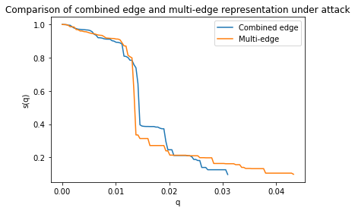
Appendix 1

Slide 9
Appendix 2

